Slide 1
The Relational Model
Chapter 2
Notes:
1

Slide 2
Why Study the Relational Model?
Most widely used model (but XML peeks up speed).
  Vendors: IBM DB2, Oracle, Microsoft SQL Server, SAP Adaptive server
  Free: MySQL, PostgreSQL, SQLite
Easy to store and index data when it is in a simple form (i.e., table)
Proposed by Boyce Codd in 1970
Notes:
2

Slide 3
Relational Database: Definitions
Relational database: a set of relations (or tables).
Relation: consist of 2 parts:
  Instance : a table, with rows and columns.
  Schema : specifies name of relation, plus name and type of each column and their domain, plus integrity constraints.
    E.g. Students(sid: string, name: string, login: string, age: integer, gpa: real)
Can think of a relation as a bag (or maybe set if key exists) of rows (a.k.a. as tuples).
Notes:
3

Slide 4
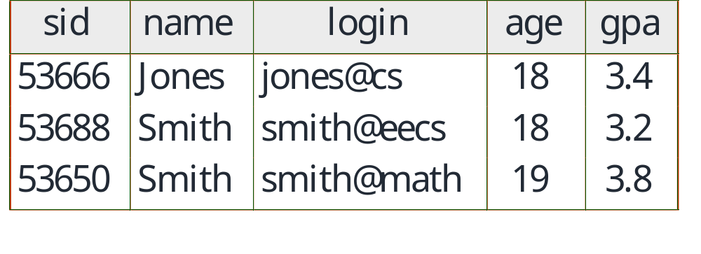
Example Instance of Students Relation
SQL DDL (data definition language)
create table Students ( sid INTEGER,
name VARCHAR(30),
login VARCHAR(20),
age INTEGER,
gpa REAL)
Notes:
4

Slide 5
Using Auto Increment
create table Students (
sid INTEGER AUTO_INCREMENT PRIMARY KEY,
name VARCHAR(30),
login VARCHAR(20),
age INTEGER,
gpa REAL);

Slide 6
Possible modifiers
NOT NULL: field cannot be null
AUTO_INCREMENT: starts with 0 and auto increments
UNSIGNED: cannot be negative
PRIAMARY KEY: it is a primary key
UNIQUE: no duplicates allowed
ZEROFILL: default value is 0

Slide 7
SQL DML (data manipulation language)
INSERT
INTO Students (sid, name, login, age, gpa)
VALUES (233, 'Smith', 'sad@abc.com', 18, 4.0)
DELETE
FROM Students
WHERE name='Smith'
UPDATE Students
SET GPA = GPA -1
WHERE sid=233

Slide 8
Example Instance of Bank Account
Acct
Name
Address
Balance
1005
Jones
11 First St
$1023.22
1002
Smith
12 First St
$22.43
1003
Smith
12 First St
$11000.12
1008
Green
14 Fourth St
$1077.23
1010
Gates
20 Tenth St
$5,000,000,000.00
1012
Smith
15 Second St
$443.77
Notes:
4

Slide 9
Integrity Constraints
e.g., Domain, primary key, foreign key constraints
integrity constraints: condition that must be true for any instance of the database; e.g., domain constraints.
  integrity constraints are specified when the schema is defined (using SQL DDL).
  they are checked when relations are modified.
A legal instance of a relation is one that satisfies all specified integrity constraints.
  DBMS should not allow illegal instances.
Notes:
5

Slide 10
Where do integrity constraints Come From?
They are based upon the semantics of the real-world enterprise that is being described in the database relations.
We can check a database instance to see if an integrity constraint is violated, but we can NEVER infer that an integrity constraint is true by looking at an instance.
  An integrity constraint is a statement about all possible instances!
Key and foreign key constraints are the most common; more general constraints also exist.

Slide 11
Primary Key Constraints
A set of fields is a candidate key for a relation if :
  1. No two distinct tuples (i.e., rows) can have the same values in all key fields, and
  2. This is not true for any subset of the key.
  Part 2 false? A superkey.
  If there is more than one candidate key for a relation, then one of the keys is chosen to be the primary key.
E.g., sid is a key for Students. (What about name?) The set {sid, gpa} is a superkey.
Notes:
6

Slide 12
Primary and Candidate Keys in SQL
Possibly many candidate keys (specified using UNIQUE), one of which is chosen as the primary key.
CREATE TABLE Enrolled
(sid INTEGER not null,
cid VARCHAR(20) not null,
grade VARCHAR(2),
PRIMARY KEY (sid,cid) )
CREATE TABLE Enrolled
(sid INTEGER not null,
cid VARCHAR(20) not null,
grade VARCHAR(2) not null,
PRIMARY KEY (sid),
UNIQUE (cid, grade))
Notes:
6

Slide 13
Primary and Candidate Keys in SQL (continued)
For Students relation with sid as the primary key
CREATE TABLE Students
(sid INTEGER not null,
name CHAR(20),
login CHAR(10), age INTEGER,
gpa REAL, PRIMARY KEY (sid) )
Are there any separate fields or combinations of fields which also are candidates for primary key?
  How about login?
  How about age?
  How about age & gpa?
Notes:
6

Slide 14
Adding Additional Indexes on Unique Fields
CREATE UNIQUE INDEX ind_login
ON Students(login);
If you change your mind:
drop INDEX ind_login on Students;
MySql will automatically create indexes for primary keys!

Slide 15
MySQL specifics (Do you need a PK?)
MySQL will not let you modify a table without a primary key.
Most DBMS require that you specify a primary key.
If you don’t have a primary key, just add an additional field of type int and make it autoincrement.

Slide 16
Foreign Keys, Referential Integrity
Foreign key : Set of fields in one relation that is used to `refer’ to a tuple in another relation. (Must correspond to primary key of the second relation.) Like a `logical pointer’.
E.g. sid is a foreign key referring to Students:
  Enrolled(sid: string, cid: string, grade: string)
A referential integrity constraint:
  the value sid in an Enrolled tuple must have the value of an existing student (i.e., there must exist a tuple in the relation Student with that sid)
Notes:
7

Slide 17
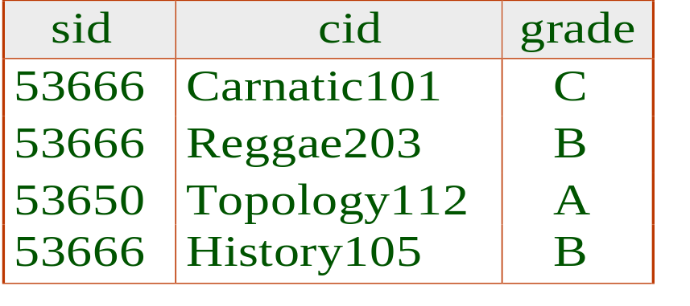
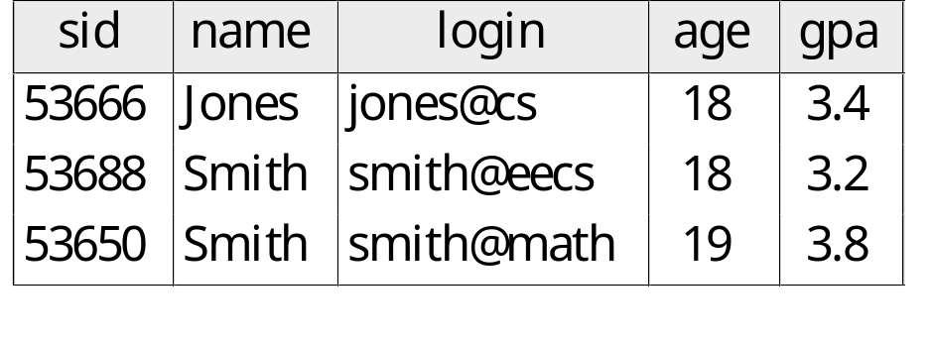
Foreign Keys in SQL
Only students listed in the Students relation should be allowed to enroll for courses.
CREATE TABLE Enrolled
(sid integer not null,cid CHAR(20) not null,
grade CHAR(2),
PRIMARY KEY (sid,cid),
FOREIGN KEY (sid) REFERENCES Students(sid) )
Enrolled
Students
Notes:
7

Slide 18
Foreign Keys in SQL (cont'd)
Bank Account Example - Only allow accounts opened for customers listed in the customer relation
First, an instance of Customer_info
Name
Address
Phone
Email
Jones
11 First St
6032223456
Jones@cs
Smith
12 First St
6033335567
Smith@cs
Green
14 Fourth St
7814447890
Green@cs
Gates
11 First St
1223336789
Gates@ms
Smith
12 Second St
6039788765
Smith@ee
Notes:
7

Slide 19
Foreign Keys in SQL (continued)
Creates the customer information relation
CREATE TABLE Customer_Info
(name VARCHAR(20) not null,
addr varCHAR(40) not null,
phone varCHAR(10), email varchar (40),
PRIMARY KEY (name, addr))
Now create the bank account relation with a foreign key
CREATE TABLE Bank_Acct
(acct VARCHAR(4) not null, name VARCHAR(20) not null,
address VARCHAR(40) not null, balance REAL,
PRIMARY KEY (acct) ,
foreign Key (name, address) references
Customer_Info(name,addr));
Notes:
7

Slide 20
Foreign Keys in SQL (cont'd)
Acct
Name
Address
Balance
1005
Jones
11 First St
$1023.22
1002
Smith
12 First St
$22.43
1003
Smith
12 First St
$11000.12
1008
Green
14 Fourth St
$1077.23
1010
Gates
20 Tenth St
$5,000,000,000.00
1012
Smith
15 Second St
$443.77
Name
Address
Phone
Email
Jones
11 First St
6032223456
Jones@cs
Smith
12 First St
6033335567
Smith@cs
Green
14 Fourth St
7814447890
Green@cs
Gates
11 First St
1223336789
Gates@ms
Smith
15 Second St
6039788765
Smith@ee
Notes:
7

Slide 21
Indexes
Indexes are automatically created for the foreign keys (in the table that has the f.k. constraint). The indices are on non-unique fields.
Creating additional indices on non-unique fields.
CREATE INDEX ind_age
ON Students(age);
If you change your mind:
drop INDEX ind_age on Students;

Slide 22
Enforcing Referential Integrity
Consider Students and Enrolled; sid in Enrolled is a foreign key that references Students.
What should be done if an Enrolled tuple with a non-existent student id is inserted? (Reject it!)
What should be done if a Students tuple is deleted?
  Also delete all Enrolled tuples that refer to it.
  Disallow deletion of a Students tuple that is referred to.
  Set sid in Enrolled tuples that refer to it to a default sid.
  (In SQL, also: Set sid in Enrolled tuples that refer to it to a special value null, denoting `unknown’ or `inapplicable’.)
Similar if primary key of Students tuple is updated.
Notes:
13

Slide 23
Referential Integrity in SQL/92
SQL/92 supports all 4 options on deletes and updates.
  Default is NO ACTION (delete/update is rejected)
  CASCADE (also delete all tuples that refer to deleted tuple)
  SET NULL / SET DEFAULT (sets foreign key value of referencing tuple)
CREATE TABLE Enrolled
(sid integer not null,
cid VARCHAR(20) not null,
grade VARCHAR(2),
PRIMARY KEY (sid,cid),
FOREIGN KEY (sid)
REFERENCES Students(sid)
ON DELETE CASCADE
ON UPDATE NO ACTION)
default: insert .... (sid integer DEFAULT 23, ...)
Notes:
14

Slide 24
CREATE TABLE Students
(sid INTEGER not null, name CHAR(20),
login CHAR(10), age INTEGER,
gpa REAL, PRIMARY KEY (sid) );
insert into Students values (1,'bob','bob',20,3.2);
CREATE TABLE Enrolled
(sid integer not null, cid VARCHAR(20) not null,
grade VARCHAR(2), PRIMARY KEY (sid,cid),
FOREIGN KEY (sid) REFERENCES Students(sid)
ON DELETE CASCADE ON UPDATE NO ACTION);
insert into Enrolled values(1,'233','A');
delete s from Students s where sid = 1;

Slide 25
The SQL Query Language
Developed by IBM (system R) in the 1970s
Need for a standard since it is used by many vendors
Standards:
  SQL-86
  SQL-89 (minor revision)
  SQL-92 (major revision, current standard)
  SQL-99 (major extensions)

Slide 26
Destroying and Altering Relations
DROP TABLE Students
Destroys the relation Students. The schema information and the tuples are deleted.
ALTER TABLE Students
ADD COLUMN maiden_name VARCHAR(10) default 'sf'
Notes:
16

Slide 27
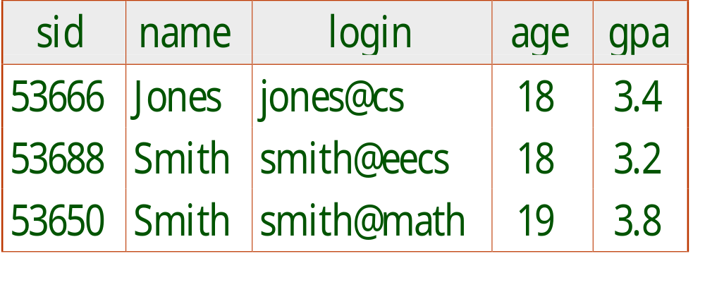
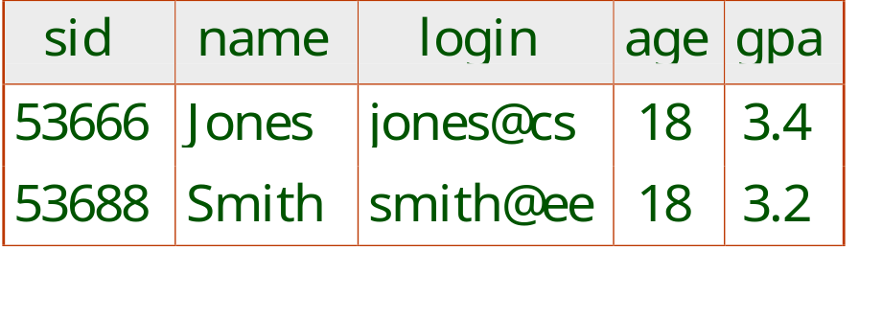
The SQL Query Language
To find all 18 year old students, we can write:
SELECT *
FROM Students S
WHERE S.age=18
To find just names and logins, replace the first line:
SELECT S.name, S.login from Students S

Slide 28
The SQL Query Language
(cont'd)
To find all bank customers whose name is Smith :
SELECT *
FROM Bank_Acct B
WHERE B.name='Smith'
Name
Address
Phone
Email
Smith
12 First St
6033335567
Smith@cs
Smith
12 Second St
6039788765
Smith@ee

Slide 29
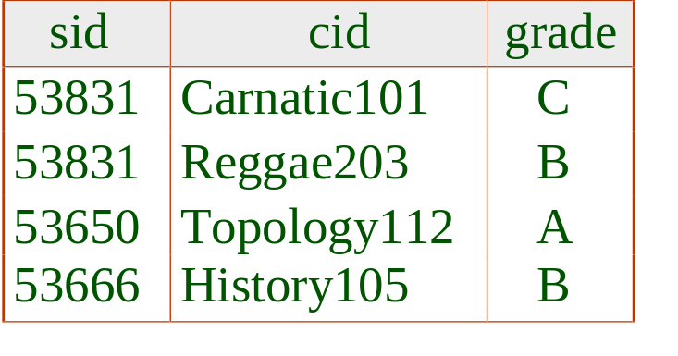
Querying Multiple Relations
What does the following query compute?
SELECT S.name, E.cid
FROM Students S, Enrolled E
WHERE S.sid=E.sid AND E.grade='B'
sid
name
login
age
gpa
53666
Jones
jones@cs
18
3.4
53688
Smith
smith@eecs
18
3.2
53650
Smith
smith@math
19
3.8
53600
Green
green@ee
18
3.5
we get:
S.name
E.cid
Jones
History 105

Slide 30
Querying Multiple Relations
(continued)
What does the following query compute
SELECT B.name, C.email
FROM Bank_Acct B, Customer_Info C
WHERE B.name=C.name AND B.addr=C.addr
AND B.balance>$1000.00
given the following instances of Bank_Acct and Customer_Info

Slide 31
Querying Multiple Relations
(continued)
Acct
Name
Address
Balance
1005
Jones
11 First St
$1023.22
1002
Smith
12 First St
$22.43
1003
Smith
12 First St
$11000.12
1008
Green
14 Fourth St
$1077.23
1010
Gates
20 Tenth St
$5,000,000,000.00
1012
Smith
15 Second St
$443.77
Name
Address
Phone
Email
Jones
11 First St
6032223456
Jones@cs
Smith
12 First St
6033335567
Smith@cs
Green
14 Fourth St
7814447890
Green@cs
Gates
11 First St
1223336789
Gates@ms
Smith
12 Second St
6039788765
Smith@ee

Slide 32
Querying Multiple Relations
(continued)
Name
Email
Jones
Jones@cs
Smith
Smith@cs
Green
Green@cs

Slide 33
Views
A view is just a relation, but we store a definition, rather than a set of tuples.
CREATE VIEW YoungActiveStudents (name, grade)
AS SELECT S.name, E.grade
FROM Students S, Enrolled E
WHERE S.sid = E.sid and S.age<21
Views can be dropped using the DROP VIEW command.
  How to handle DROP TABLE if there’s a view on the table?
    MySQL currently doesn’t help you much. An error is generated if the Students table is dropped and you try to access the YoungActiveStudents table.
Notes:
18

Slide 34
Views and Security
Views can be used to present necessary information (or a summary), while hiding details in underlying relation(s).
  Given YoungStudents, but not Students or Enrolled, we can find students who are enrolled, but not the cid’s of the courses they are enrolled in.
Notes:
22

Slide 35
Updates on views
difficult because it is not always unambiguous.
It might be possible depending on the syntax of the view definition query.

Slide 36
Alternative
CREATE table YoungActiveStudents (name VARCHAR(20), grade VARCHAR(2));
INSERT INTO YoungActiveStudents
SELECT S.name, E.grade
FROM Students S, Enrolled E
WHERE S.sid = E.sid and S.age<21;

Slide 37
Temp Tables
A Temporary table is visible only to the current session,
and is dropped automatically when the session is closed.
This means that two different sessions can use the same
temporary table name without conflicting with each other or
with an existing non-TEMPORARY table of the same name.
To create temporary tables, use the syntax:
CREATE TEMPORARY TABLE

Slide 38
Relational Model: Summary
A tabular representation of data.
Simple and intuitive, currently the most widely used.
Integrity constraints can be specified by the DBA, based on application semantics. DBMS checks for violations.
  Two important ICs: primary and foreign keys
  In addition, we always have domain constraints.
Powerful and natural query languages exist.
Indexes are key for tuning the database and getting good performance.
Notes:
15

